Slide 1

DSI-SG-42 | Conrad Aw | Pius Yee | Eugene Matthew Cheong
Stakeholder Meeting

Slide 2
Persona Introduction

Slide 3

Persona Introduction
George, 33
Campaign Strategist
Assigned a project to create campaigns for mothers.
Had troubles classifying articles or post written by mothers.
Noticed that he and his team had discrepancies in the findings, complicating the analysis process.

Slide 4


Slide 5
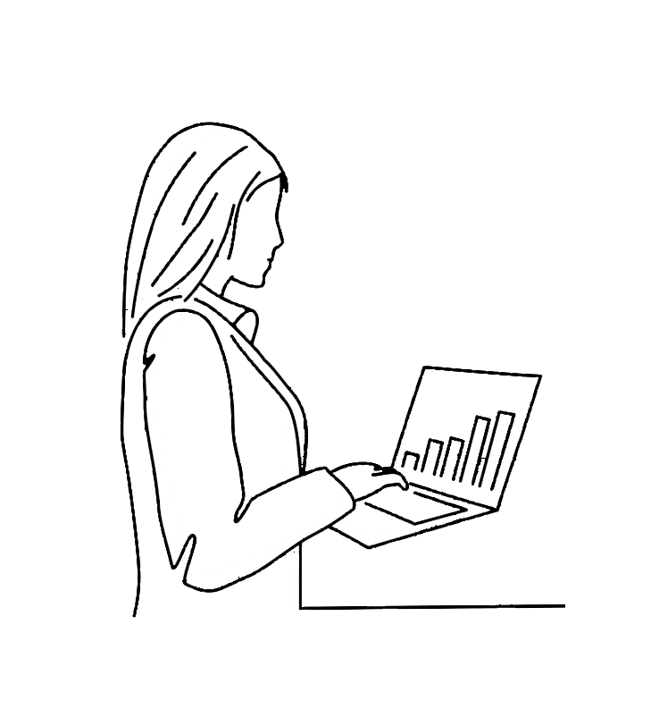
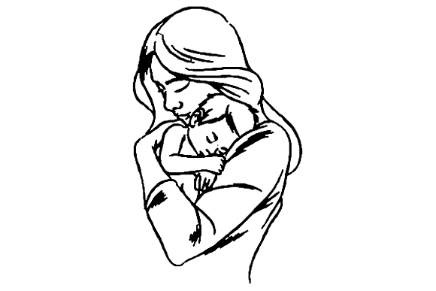
Mothers
Work life
Parenting

Slide 6







Slide 7
Information

Slide 8
Information
Discussions

Slide 9
Information
Discussions
Anonymous Support

Slide 10
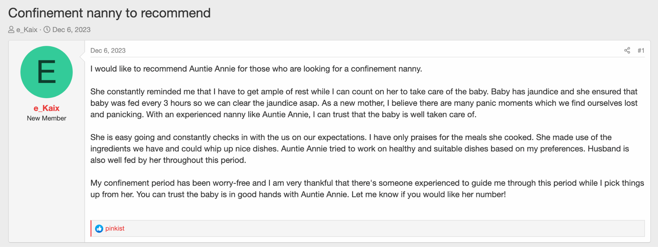
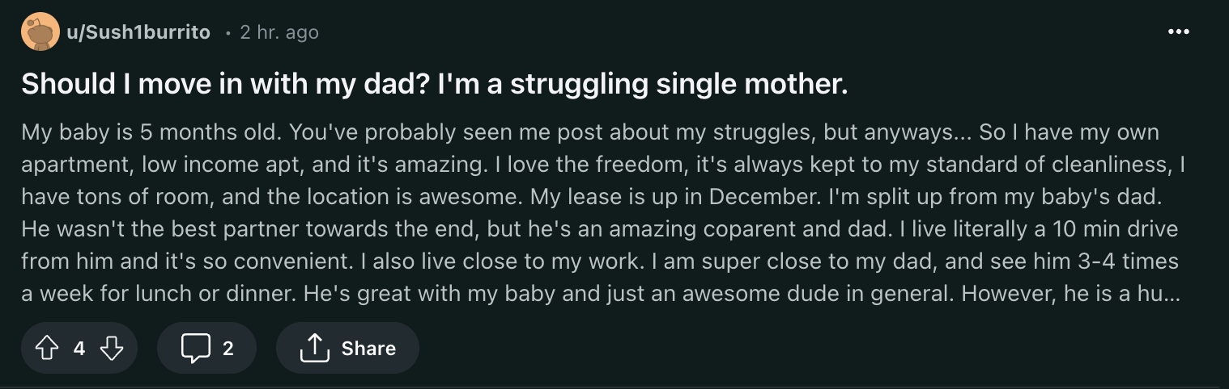
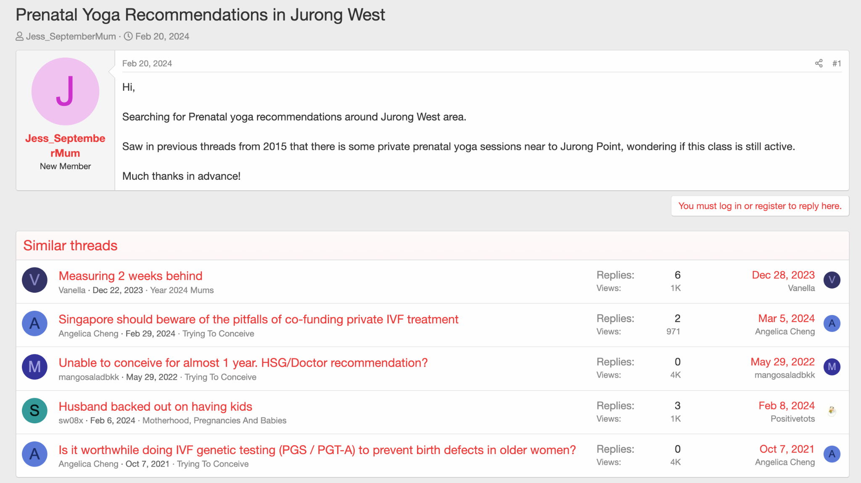
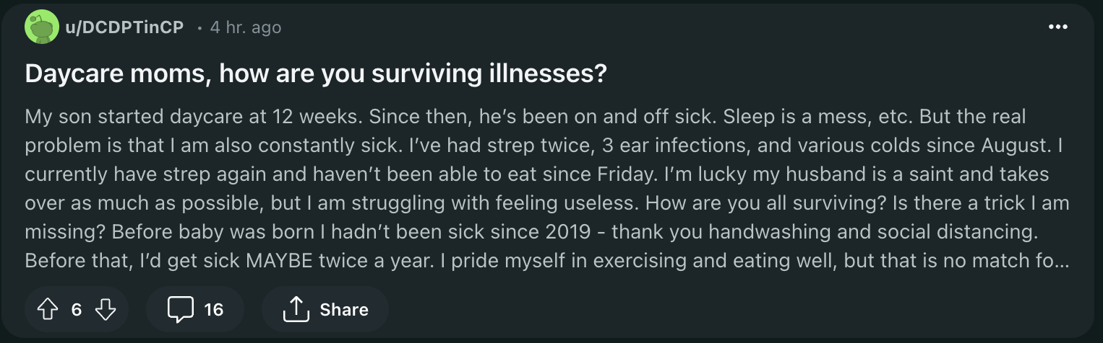

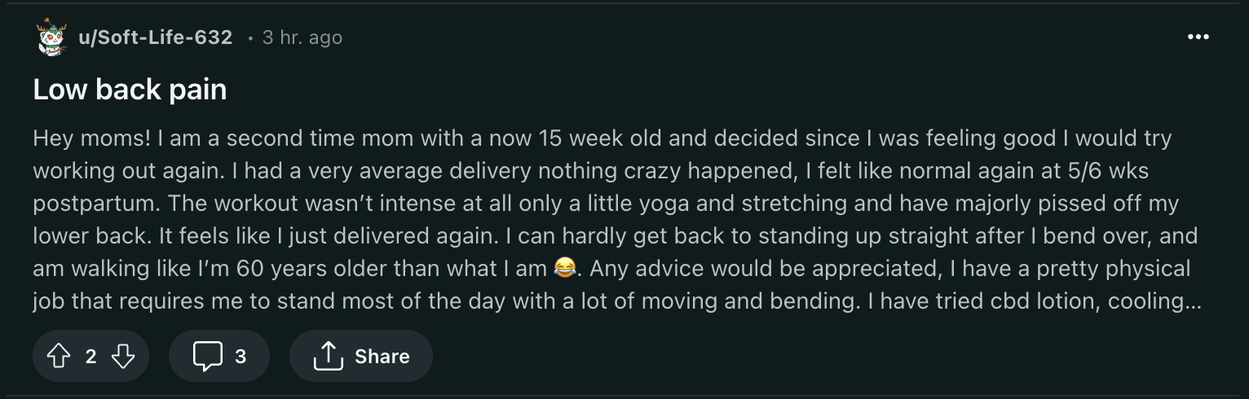
Tedious Research

Slide 11
Problem Statement

Slide 12
In light of the current generation of mothers’ high engagement on social media and forums, particularly in discussions related to work-life balance and childcare, our Campaign Strategists face challenges in consistently identifying and classifying relevant topics for our campaigns. This reliance on personal assumptions rather than empirical evidence hampers the effectiveness of our campaigns or programs, hindering our ability to optimize online presence and effectively reach our target audience.

Slide 13
Classification Model

Slide 14
Classification
Mothers
Fathers

Slide 15




✅
Define the problem
Data Collection
Data Cleaning & Preprocessing
Exploratory Data Analysis
Modelling
Model Evaluation
Notes:
Data Collection
Criterias for selection of subreddits
Webscrap on Reddit via official API
Steps and
Data Cleaning & Preprocessing
EDA
Characteristics that differentiate Mom and Dad comments:
How length of comments differentiate Moms and Dads
Top word counts
N-gram analysis

Slide 16
✅
Define the problem
Data Collection
Data Cleaning & Preprocessing
Exploratory Data Analysis
Modelling
Model Evaluation
Notes:
Data Collection
Criterias for selection of subreddits
Webscrap on Reddit via official API
Steps and
Data Cleaning & Preprocessing
EDA
Characteristics that differentiate Mom and Dad comments:
How length of comments differentiate Moms and Dads
Top word counts
N-gram analysis

Slide 17
Criterias for selection
r/Mummit
r/Daddit
Relevance
Activity &
Engagement level
Membership
Size
Moderation
Quality of Content
Variety
Notes:
Criterias that we considered for selection of subreddits:
1) Relevance: The discussions and subjects in the subreddit must be relevant to Mothers and Fathers as these are the main protagonist of our target group.
2) Activity & Engagement Level: The subreddit needs to be active and engaging based on the number of posts and comments as higher activity levels may provide more interesting data for analysis.
3) Size: The member size of the subreddit is important as larger subreddits may have more diverse content and discussions while smaller subreddits may have more focused discussions on specific topics.
4) Moderation: Strong moderation preferred to ensure fewer spam or irrelevant posts.
5) Quality of Content: Quality of content based on post and comments level of detail and informativeness.
6) Variety: Consider selecting a mix of subreddits to get a diverse range of content and perspectives.

Slide 18
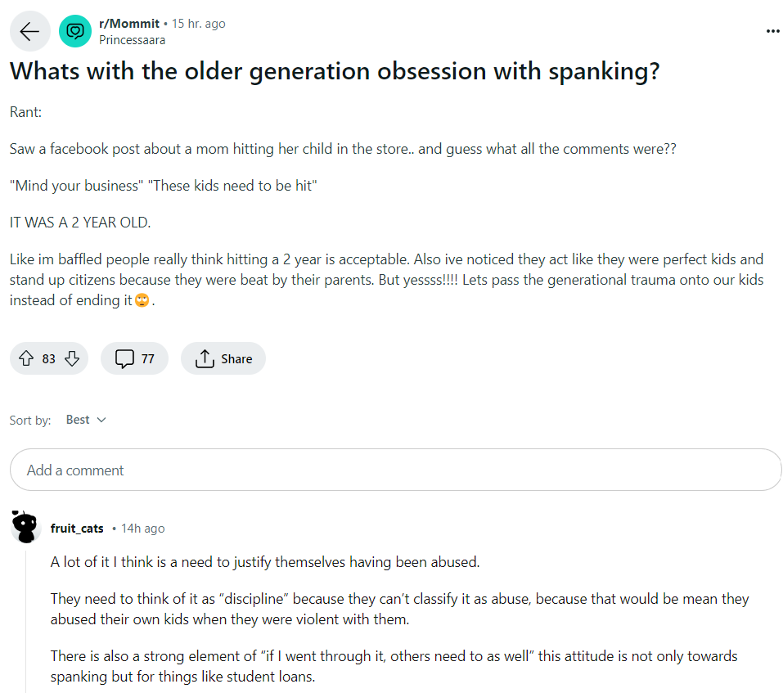
Text scraping
subreddit
Title
Post
Comment
Notes:
Objective: Collect textual data from specified websites for the purpose of conducting a Natural Language Processing (NLP) analysis
Steps:
Iterate through posts and comments, filtering based on criteria such as date range, keywords, or score.
Extract relevant information such as post titles, content, comments, timestamps, and author usernames.
Imagine you're interested in what people are talking about in a particular online community, like a book club or a cooking forum. Reddit is a website where people form communities, called subreddits, around different topics. In each subreddit, members share posts and comments about that topic.
Now, let's say you want to understand what's popular in a cooking subreddit. You might want to see what recipes people are sharing, what ingredients they're talking about, or if there are any new cooking trends. To do this, you can use a process called "text scraping."
Text scraping is like collecting all the notes from a big community board. You use a computer program to automatically gather all the posts and comments from the subreddit you're interested in. This program can read through the webpage and pick out the text from the posts and comments, just like you would if you were reading them yourself.
Once you have all this text, you can start looking for patterns or interesting information. For example, you might notice that a lot of people are talking about a new way to bake bread, or you might find that everyone is using a particular spice in their recipes.
In summary, text scraping of subreddit posts and comments is like using a computer program to collect all the conversations from an online community so you can learn more about what people are talking about and interested in.

Slide 19
✅
✅
Define the problem
Data Collection
Data Cleaning & Preprocessing
Exploratory Data Analysis
Modelling
Model Evaluation
Notes:
Data Collection
Criterias for selection of subreddits
Webscrap on Reddit via official API
Steps and
Data Cleaning & Preprocessing
EDA
Characteristics that differentiate Mom and Dad comments:
How length of comments differentiate Moms and Dads
Top word counts
N-gram analysis

Slide 20
✅
✅
Define the problem
Data Collection
Data Cleaning & Preprocessing
Exploratory Data Analysis
Modelling
Model Evaluation
Notes:
Data Cleaning & Preprocessing
EDA
Characteristics that differentiate Mom and Dad comments:
How length of comments differentiate Moms and Dads
Top word counts
N-gram analysis

Slide 21
Data Cleaning
✅
Raw data collected
Cleaned data
<praw.models.comment_forest.CommentForest object at 0x31f8ec310>
. , + , * , ? , ^ , $ , ( , ) , [ , ] , { , } , | , \ , ! , @ , # , % , &
Blank rows
Auto-replies or system messages
[removed] and [deleted]
\n
Notes:
To clean the text for tokenization, we can follow these steps:
Convert to Lowercase: Standardize the text by converting all characters to lowercase.
Remove Punctuation: Eliminate punctuation marks to avoid splitting tokens at these symbols.
Handle Contractions: Expand contractions (e.g., "don't" to "do not") to ensure consistency in tokenization.

Slide 22
Preprocessing
"this was my daughter we tried everything and the only thing that worked was being held i do not have any tips because nothing worked for us when she was around 18-20 months i coslept with her because i was falling apart from sleep deprivation she is 3 years old now and sleeps through the night in her own bed with zero issues so while it has been an absolute brutal couple of years shes a great independent sleeper now"
1
['this', 'was', 'my', 'daughter', 'we', 'tried', 'everything', 'and', 'the', 'only', 'thing', 'that', 'worked', 'was', 'being', 'held', 'i', 'do', 'not', 'have', 'any', 'tips', 'because', 'nothing', 'worked', 'for', 'us', 'when', 'she', 'was', 'around', '18-20', 'months', 'i', 'coslept', 'with', 'her', 'because', 'i', 'was', 'falling', 'apart', 'from', 'sleep', 'deprivation', 'she', 'is', '3', 'years', 'old', 'now', 'and', 'sleeps', 'through', 'the', 'night', 'in', 'her', 'own', 'bed', 'with', 'zero', 'issues', 'so', 'while', 'it', 'has', 'been', 'an', 'absolute', 'brutal', 'couple', 'of', 'years', 'shes', 'a', 'great', 'independent', 'sleeper', 'now']
Tokenization
['this', 'was', 'my', 'daughter', 'we', 'tried', 'everything', 'and', 'the', 'only', 'thing', 'that', 'worked', 'was', 'being', 'held', 'i', 'do', 'not', 'have', 'any', 'tips', 'because', 'nothing', 'worked', 'for', 'us', 'when', 'she', 'was', 'around', '18-20', 'months', 'i', 'coslept', 'with', 'her', 'because', 'i', 'was', 'falling', 'apart', 'from', 'sleep', 'deprivation', 'she', 'is', '3', 'years', 'old', 'now', 'and', 'sleeps', 'through', 'the', 'night', 'in', 'her', 'own', 'bed', 'with', 'zero', 'issues', 'so', 'while', 'it', 'has', 'been', 'an', 'absolute', 'brutal', 'couple', 'of', 'years', 'shes', 'a', 'great', 'independent', 'sleeper', 'now']
2
['daughter', 'tried', 'everything', 'thing', 'worked', 'held', 'tips', 'worked', 'us', 'around', '18-20', 'months', 'coslept', 'falling', 'apart', 'sleep', 'deprivation', '3', 'years', 'old', 'sleeps', 'night', 'bed', 'zero', 'issues', 'absolute', 'brutal', 'couple', 'years', 'shes', 'great', 'independent', 'sleeper']
Stop Word removal
['daughter', 'tried', 'everything', 'thing', 'worked', 'held', 'tips', 'worked', 'us', 'around', '18-20', 'months', 'coslept', 'falling', 'apart', 'sleep', 'deprivation', '3', 'years', 'old', 'sleeps', 'night', 'bed', 'zero', 'issues', 'absolute', 'brutal', 'couple', 'years', 'shes', 'great', 'independent', 'sleeper']
['daughter', 'try', 'everything', 'thing', 'work', 'hold', 'tip', 'work', 'us', 'around', '18-20', 'month', 'coslept', 'fall', 'apart', 'sleep', 'deprivation', '3', 'year', 'old', 'sleep', 'night', 'bed', 'zero', 'issue', 'absolute', 'brutal', 'couple', 'year', 'she', 'great', 'independent', 'sleeper']
3
['daughter', 'try', 'everything', 'thing', 'work', 'hold', 'tip', 'work', 'us', 'around', '18-20', 'month', 'coslept', 'fall', 'apart', 'sleep', 'deprivation', '3', 'year', 'old', 'sleep', 'night', 'bed', 'zero', 'issue', 'absolute', 'brutal', 'couple', 'year', 'she', 'great', 'independent', 'sleeper']
Lemmatization
✔
Ready for Exploratory Data Analysis
Notes:
Tokenization is the process of breaking down text into smaller units, such as words or phrases. Each word in the text is treated as a separate token. Note that the numbers "18-20" and "3" are also treated as tokens in this example.
Stop words are common words that are often removed in natural language processing (NLP) tasks because they carry little semantic meaning.
Lemmatization is the process of converting words to their base or root form.
Tokenization with Regex: Chopping text into smaller, digestible pieces for computers. We use tokenization with regex breaks text into words for model training.
Stop Word Removal: Frequently occurring words with low semantic value are filtered out. This process helps reduce noise, improve computational efficiency, and emphasize the more content-rich words within the text.
E.g. “is’, “a”, “the”, “of”
Lemmatization: A linguistic normalization technique in natural language processing (NLP) that converts inflected forms of a word to its base form or lemma. It uses vocabulary and morphological analysis to determine the correct lemma, taking into consideration the word's part of speech and its context within the text. This process helps in reducing the feature space and improving the accuracy of NLP models by grouping together different variants of the same word.
E.g. (running, runs, ran) > run

Slide 23
✅
✅
Define the problem
Data Collection
✅
Data Cleaning & Preprocessing
Exploratory Data Analysis
Modelling
Model Evaluation
Notes:
Data Collection
Criterias for selection of subreddits
Webscrap on Reddit via official API
Steps and
Data Cleaning & Preprocessing
EDA
Characteristics that differentiate Mom and Dad comments:
How length of comments differentiate Moms and Dads
Top word counts
N-gram analysis

Slide 24
✅
✅
Define the problem
Data Collection
✅
Data Cleaning & Preprocessing
Exploratory Data Analysis
Modelling
Model Evaluation
Notes:
Data Collection
Criterias for selection of subreddits
Webscrap on Reddit via official API
Steps and
Data Cleaning & Preprocessing
EDA
Characteristics that differentiate Mom and Dad comments:
How length of comments differentiate Moms and Dads
Top word counts
N-gram analysis

Slide 25
Exploratory Data Analysis
Comment and post length
Sentiment Analysis
N-gram analysis
Notes:
Data Collection
Criterias for selection of subreddits
Webscrap on Reddit via official API
Steps and
Data Cleaning & Preprocessing
EDA
Characteristics that differentiate Mom and Dad comments:
How length of comments differentiate Moms and Dads
Top word counts
N-gram analysis

Slide 26
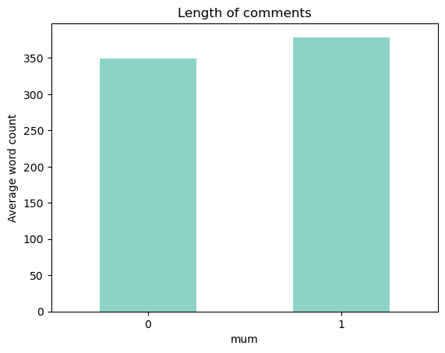
Length of comments
Mothers
Notes:
Data Collection
Criterias for selection of subreddits
Webscrap on Reddit via official API
Steps and
Data Cleaning & Preprocessing
EDA
Characteristics that differentiate Mom and Dad comments:
How length of comments differentiate Moms and Dads
Top word counts
N-gram analysis

Slide 27
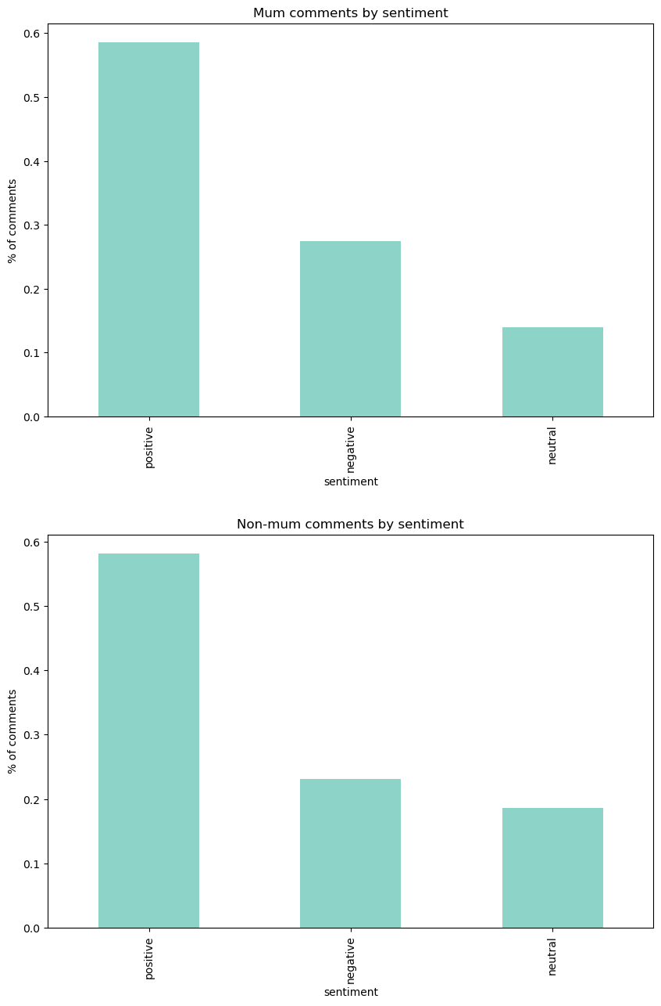
2) Sentiment Analysis
Mothers’ comments by sentiment
Fathers’ comments by sentiment
% of comments
% of comments
Positive
Negative
Neutral
Positive
Negative
Neutral
Sentiment
Sentiment
Notes:
Data Collection
Criterias for selection of subreddits
Webscrap on Reddit via official API
Steps and
Data Cleaning & Preprocessing
EDA
Characteristics that differentiate Mom and Dad comments:
How length of comments differentiate Moms and Dads
Top word counts
N-gram analysis

Slide 28
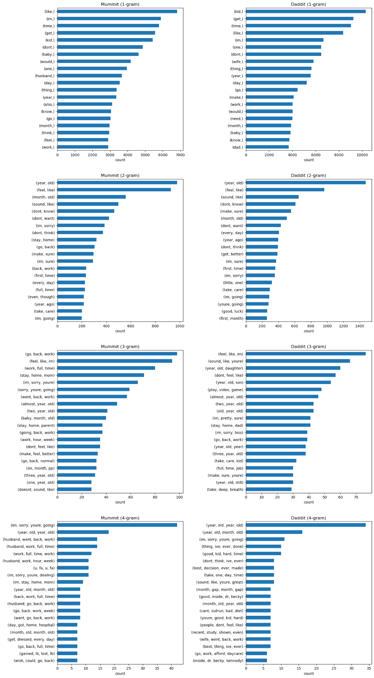
Mummit (1-gram)
Daddit (1-gram)
Notes:
N-gram analysis is a technique used in text processing and analysis, where 'n' refers to the number of words or characters grouped together. It helps in understanding the context or the sequence in which words appear in the text. Here's a breakdown of the concept in layman's terms:
1-gram (Unigram): This is the simplest form of n-gram analysis where each word is considered individually. For example, in the sentence "The cat sat on the mat," the 1-grams would be: "The," "cat," "sat," "on," "the," "mat."
2-gram (Bigram): In this case, pairs of words are considered together. For the same sentence, the 2-grams would be: "The cat," "cat sat," "sat on," "on the," "the mat."
3-gram (Trigram): Here, groups of three words are analyzed together. The trigrams for the sentence would be: "The cat sat," "cat sat on," "sat on the," "on the mat."
4-gram: This involves groups of four words. The 4-grams for our example sentence would be: "The cat sat on," "cat sat on the," "sat on the mat."
N-gram analysis is useful in various applications such as language modeling, text prediction, and sentiment analysis. It helps in capturing the context and structure of the language, which is crucial for understanding the meaning and intent of the text.

Slide 29
Mummit (2-gram)
Daddit (2-gram)
Notes:
Data Collection
Criterias for selection of subreddits
Webscrap on Reddit via official API
Steps and
Data Cleaning & Preprocessing
EDA
Characteristics that differentiate Mom and Dad comments:
How length of comments differentiate Moms and Dads
Top word counts
N-gram analysis

Slide 30
Mummit (3-gram)
Daddit (3-gram)
Mummit (3-gram)
Daddit (3-gram)
Notes:
Data Collection
Criterias for selection of subreddits
Webscrap on Reddit via official API
Steps and
Data Cleaning & Preprocessing
EDA
Characteristics that differentiate Mom and Dad comments:
How length of comments differentiate Moms and Dads
Top word counts
N-gram analysis

Slide 31
Mummit (4-gram)
Daddit (4-gram)
Notes:
Data Collection
Criterias for selection of subreddits
Webscrap on Reddit via official API
Steps and
Data Cleaning & Preprocessing
EDA
Characteristics that differentiate Mom and Dad comments:
How length of comments differentiate Moms and Dads
Top word counts
N-gram analysis

Slide 32
✅
✅
Define the problem
Data Collection
✅
✅
Data Cleaning & Preprocessing
Exploratory Data Analysis
Modelling
Model Evaluation
Notes:
Data Collection
Criterias for selection of subreddits
Webscrap on Reddit via official API
Steps and
Data Cleaning & Preprocessing
EDA
Characteristics that differentiate Mom and Dad comments:
How length of comments differentiate Moms and Dads
Top word counts
N-gram analysis

Slide 33
✅
✅
Define the problem
Data Collection
✅
✅
Data Cleaning & Preprocessing
Exploratory Data Analysis
Modelling
Model Evaluation
Notes:
Data Collection
Criterias for selection of subreddits
Webscrap on Reddit via official API
Steps and
Data Cleaning & Preprocessing
EDA
Characteristics that differentiate Mom and Dad comments:
How length of comments differentiate Moms and Dads
Top word counts
N-gram analysis

Slide 34
The Model

Slide 35
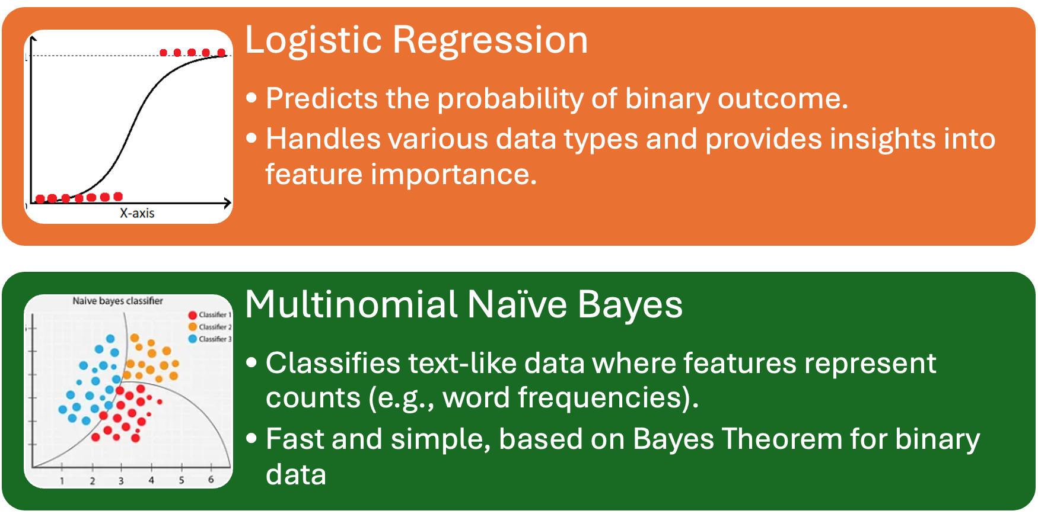
Types of models
Notes:
Data Collection
Criterias for selection of subreddits
Webscrap on Reddit via official API
Steps and
Data Cleaning & Preprocessing
EDA
Characteristics that differentiate Mom and Dad comments:
How length of comments differentiate Moms and Dads
Top word counts
N-gram analysis

Slide 36
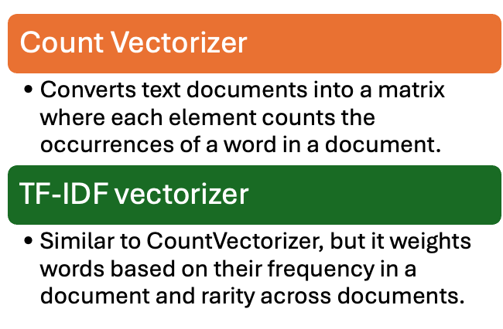
Types of text vectorizers
Notes:
Data Collection
Criterias for selection of subreddits
Webscrap on Reddit via official API
Steps and
Data Cleaning & Preprocessing
EDA
Characteristics that differentiate Mom and Dad comments:
How length of comments differentiate Moms and Dads
Top word counts
N-gram analysis

Slide 37
✅
✅
Define the problem
Data Collection
✅
✅
Data Cleaning & Preprocessing
Exploratory Data Analysis
✅
Modelling
Model Evaluation
Notes:
Data Collection
Criterias for selection of subreddits
Webscrap on Reddit via official API
Steps and
Data Cleaning & Preprocessing
EDA
Characteristics that differentiate Mom and Dad comments:
How length of comments differentiate Moms and Dads
Top word counts
N-gram analysis

Slide 38
✅
✅
Define the problem
Data Collection
✅
✅
Data Cleaning & Preprocessing
Exploratory Data Analysis
✅
Modelling
Model Evaluation
Notes:
Data Collection
Criterias for selection of subreddits
Webscrap on Reddit via official API
Steps and
Data Cleaning & Preprocessing
EDA
Characteristics that differentiate Mom and Dad comments:
How length of comments differentiate Moms and Dads
Top word counts
N-gram analysis

Slide 39
Model scores
 | Model | Vectorizer | F1 score on train data | F1 score on test data | Sensitivity | Precision | Specificity | Accuracy
1 | Naive Bayes - Multinomial | CountVectorizer | 0.765 | 0.731 | 0.709 | 0.755 | 0.854 | 0.798
2 | Naive Bayes - Multinomial | TF-IDF Vectorizer | 0.700 | 0.640 | 0.514 | 0.848 | 0.942 | 0.776
3 | Logistics Regression | CountVectorizer | 0.845 | 0.710 | 0.656 | 0.775 | 0.879 | 0.792
4 | Logistics Regression | TF-IDF Vectorizer | 0.780 | 0.716 | 0.650 | 0.797 | 0.895 | 0.800
Notes:
Data Collection
Criterias for selection of subreddits
Webscrap on Reddit via official API
Steps and
Data Cleaning & Preprocessing
EDA
Characteristics that differentiate Mom and Dad comments:
How length of comments differentiate Moms and Dads
Top word counts
N-gram analysis

Slide 40
Model scores
 | Model | Vectorizer | F1 score on train data | F1 score on test data | Sensitivity | Precision | Specificity | Accuracy
1 | Naive Bayes - Multinomial | CountVectorizer | 0.765 | 0.731 | 0.709 | 0.755 | 0.854 | 0.798
2 | Naive Bayes - Multinomial | TF-IDF Vectorizer | 0.700 | 0.640 | 0.514 | 0.848 | 0.942 | 0.776
3 | Logistics Regression | CountVectorizer | 0.845 | 0.710 | 0.656 | 0.775 | 0.879 | 0.792
4 | Logistics Regression | TF-IDF Vectorizer | 0.780 | 0.716 | 0.650 | 0.797 | 0.895 | 0.800
F1 score is our primary metric.
Notes:
Data Collection
Criterias for selection of subreddits
Webscrap on Reddit via official API
Steps and
Data Cleaning & Preprocessing
EDA
Characteristics that differentiate Mom and Dad comments:
How length of comments differentiate Moms and Dads
Top word counts
N-gram analysis

Slide 41
Metrics
 | Model | Vectorizer | F1 score on train data | F1 score on test data | Sensitivity | Precision | Specificity | Accuracy
1 | Naive Bayes - Multinomial | CountVectorizer | 0.765 | 0.731 | 0.709 | 0.755 | 0.854 | 0.798
F1 score:
Harmonic mean of sensitivity and precision, combining both metrics into a single score that penalizes models with uneven class distribution.
Best balance of precision and sensitivity
Notes:
Data Collection
Criterias for selection of subreddits
Webscrap on Reddit via official API
Steps and
Data Cleaning & Preprocessing
EDA
Characteristics that differentiate Mom and Dad comments:
How length of comments differentiate Moms and Dads
Top word counts
N-gram analysis

Slide 42
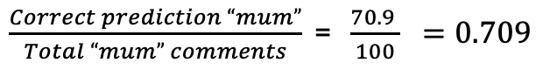
Metrics
 | Model | Vectorizer | F1 score on train data | F1 score on test data | Sensitivity | Precision | Specificity | Accuracy
1 | Naive Bayes - Multinomial | CountVectorizer | 0.765 | 0.731 | 0.709 | 0.755 | 0.854 | 0.798
Sensitivity:
The proportion of actual positive cases that the model correctly identified (true positives out of all positive examples).
For example:
Notes:
Data Collection
Criterias for selection of subreddits
Webscrap on Reddit via official API
Steps and
Data Cleaning & Preprocessing
EDA
Characteristics that differentiate Mom and Dad comments:
How length of comments differentiate Moms and Dads
Top word counts
N-gram analysis
4) Sensitivity - How many actual “mum” comments the model correctly identifies
Precision - how many of your predicted “mum” comments are actually from mothers

Slide 43
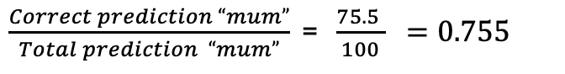
Metrics
 | Model | Vectorizer | F1 score on train data | F1 score on test data | Sensitivity | Precision | Specificity | Accuracy
1 | Naive Bayes - Multinomial | CountVectorizer | 0.765 | 0.731 | 0.709 | 0.755 | 0.854 | 0.798
Precision:
Measures the proportion of positive predictions that were actually correct (positive predictive value).
For example:
Notes:
Data Collection
Criterias for selection of subreddits
Webscrap on Reddit via official API
Steps and
Data Cleaning & Preprocessing
EDA
Characteristics that differentiate Mom and Dad comments:
How length of comments differentiate Moms and Dads
Top word counts
N-gram analysis

Slide 44
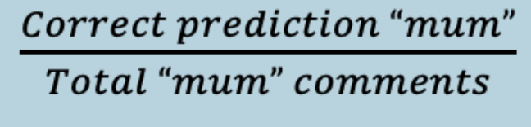
Metrics
 | Model | Vectorizer | F1 score on train data | F1 score on test data | Sensitivity | Precision | Specificity | Accuracy
1 | Naive Bayes - Multinomial | CountVectorizer | 0.765 | 0.731 | 0.709 | 0.755 | 0.854 | 0.798
Precision:
Measures the proportion of positive predictions that were actually correct (positive predictive value).
For example:
Sensitivity =
Notes:
Data Collection
Criterias for selection of subreddits
Webscrap on Reddit via official API
Steps and
Data Cleaning & Preprocessing
EDA
Characteristics that differentiate Mom and Dad comments:
How length of comments differentiate Moms and Dads
Top word counts
N-gram analysis

Slide 45
Why F1 score?
 | Model | Vectorizer | Precision train data | Precision on test data | Sensitivity | F1 score | Accuracy
 | Logistics Regression | TF-IDF vectorizer | 0.976 | 0.933 | 0.001 | 0.023 | 0.615
Initially we used Precision as our main metric to assess the model.
The scores were very good.
🥰
Notes:
Data Collection
Criterias for selection of subreddits
Webscrap on Reddit via official API
Steps and
Data Cleaning & Preprocessing
EDA
Characteristics that differentiate Mom and Dad comments:
How length of comments differentiate Moms and Dads
Top word counts
N-gram analysis

Slide 46
Why F1 score?
 | Model | Vectorizer | Precision train data | Precision on test data | Sensitivity | F1 score | Accuracy
 | Logistics Regression | TF-IDF vectorizer | 0.976 | 0.933 | 0.001 | 0.023 | 0.615
😱
But sensitivity was very low!
Notes:
Data Collection
Criterias for selection of subreddits
Webscrap on Reddit via official API
Steps and
Data Cleaning & Preprocessing
EDA
Characteristics that differentiate Mom and Dad comments:
How length of comments differentiate Moms and Dads
Top word counts
N-gram analysis

Slide 47
Model scores
 | Model | Vectorizer | F1 score on train data | F1 score on test data | Sensitivity | Precision | Specificity | Accuracy
1 | Naive Bayes - Multinomial | CountVectorizer | 0.765 | 0.731 | 0.709 | 0.755 | 0.854 | 0.798
2 | Naive Bayes - Multinomial | TF-IDF Vectorizer | 0.700 | 0.640 | 0.514 | 0.848 | 0.942 | 0.776
3 | Logistics Regression | CountVectorizer | 0.845 | 0.710 | 0.656 | 0.775 | 0.879 | 0.792
4 | Logistics Regression | TF-IDF Vectorizer | 0.780 | 0.716 | 0.650 | 0.797 | 0.895 | 0.800
Final model = Naive Bayes with CountVectorizer
Notes:
Data Collection
Criterias for selection of subreddits
Webscrap on Reddit via official API
Steps and
Data Cleaning & Preprocessing
EDA
Characteristics that differentiate Mom and Dad comments:
How length of comments differentiate Moms and Dads
Top word counts
N-gram analysis

Slide 48
✅
✅
Define the problem
Data Collection
✅
✅
Data Cleaning & Preprocessing
Exploratory Data Analysis
✅
✅
Modelling
Model Evaluation
Notes:
Data Collection
Criterias for selection of subreddits
Webscrap on Reddit via official API
Steps and
Data Cleaning & Preprocessing
EDA
Characteristics that differentiate Mom and Dad comments:
How length of comments differentiate Moms and Dads
Top word counts
N-gram analysis

Slide 49
Limitations of the Model

Slide 50
Limitations of the Model
Unable to identify localized words
The model was trained on data from the global subreddits r/daddit and r/Mummit
2) Performance of the model is constrained by limitations in the selected models.
Exhaustive tuning did not yield substantial improvements.
Notes:
Data Collection
Criterias for selection of subreddits
Webscrap on Reddit via official API
Steps and
Data Cleaning & Preprocessing
EDA
Characteristics that differentiate Mom and Dad comments:
How length of comments differentiate Moms and Dads
Top word counts
N-gram analysis

Slide 51
Classification
Mothers
Fathers

Slide 52
How can we apply this Classifier model?

Slide 53
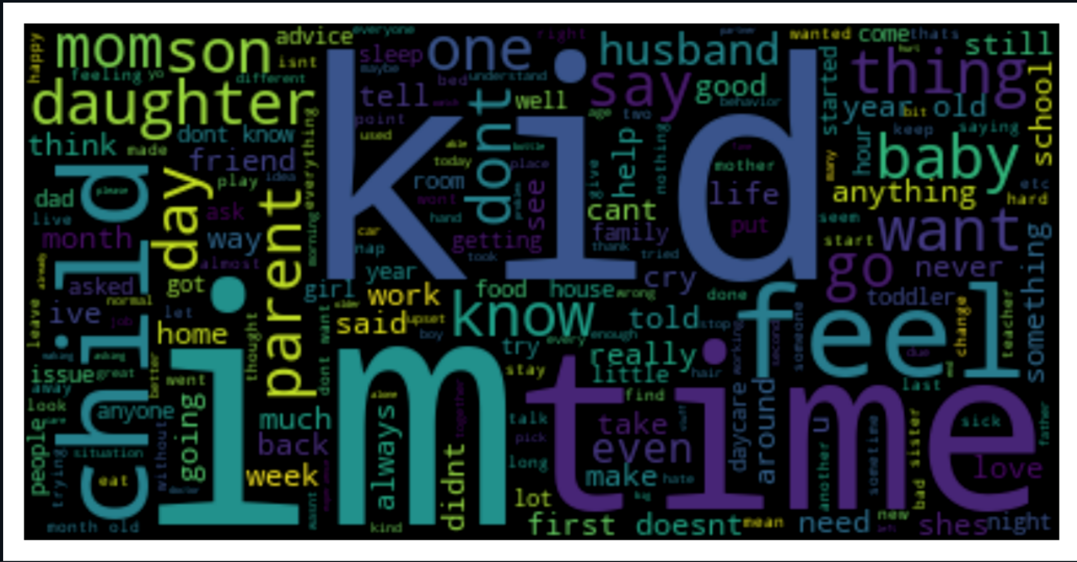

Afternoon Tea 🫖 App

Slide 54

Afternoon Tea 🫖 App
Demo

Slide 55

George, 33
Campaign Strategist
Had troubles classifying articles or post written by mothers.
Noticed that he and his team had discrepancies in the findings, complicating the analysis process.

Slide 56
What’s Next
With more resources:
We can acquire more localized data from either from other social media platforms or forums.
For example: Picking up Singlish.
Use more complex models such as Random Forest or XGBoost.
To have more accurate classification.

Slide 57

Thank you!

